Slide 1

NARS Restaurant Management System
Usability test result

Slide 2

Outlines
Observation
Sketches and Paper prototype
Dynamic prototype
Usability testing
Usability testing benefits
Tasks
Usability Results
Survey Result

Slide 3


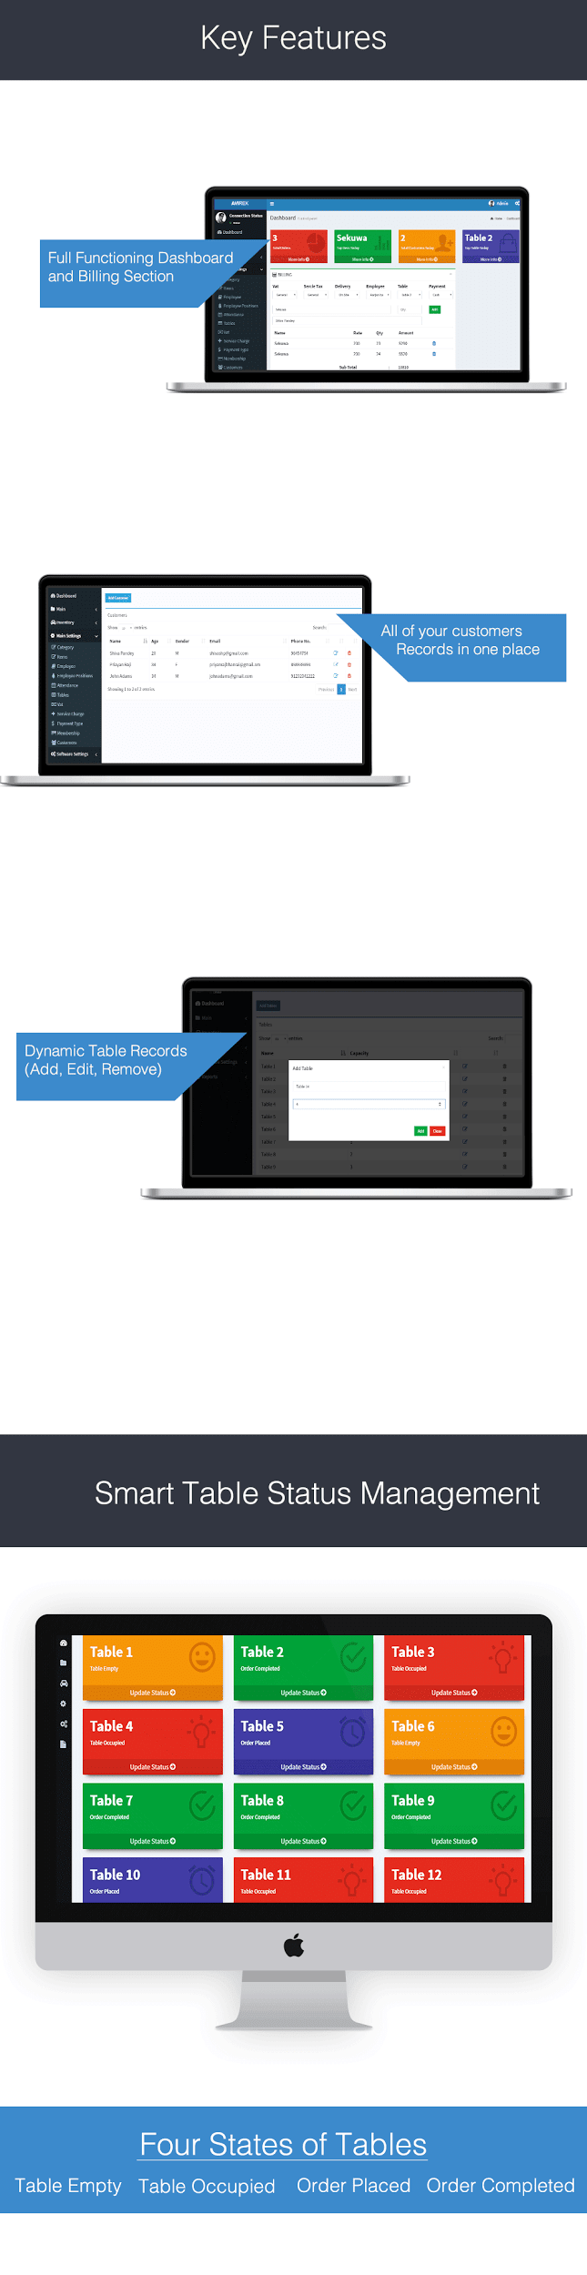
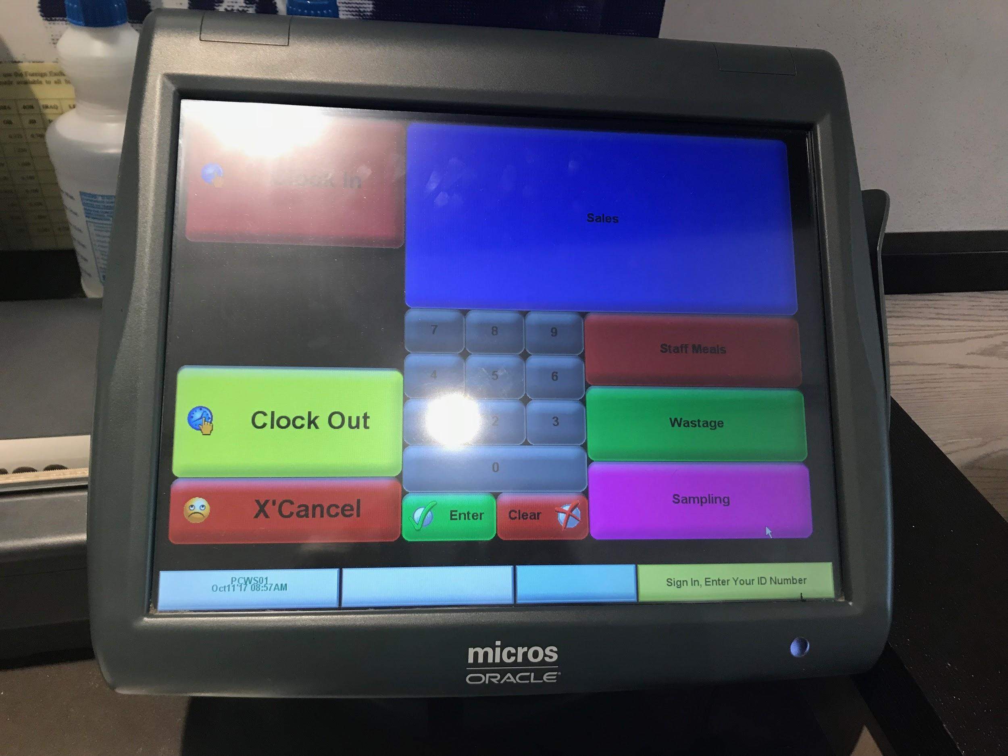
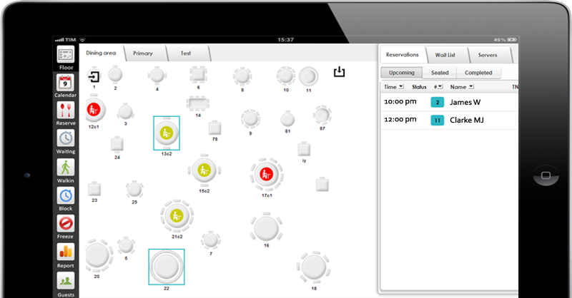
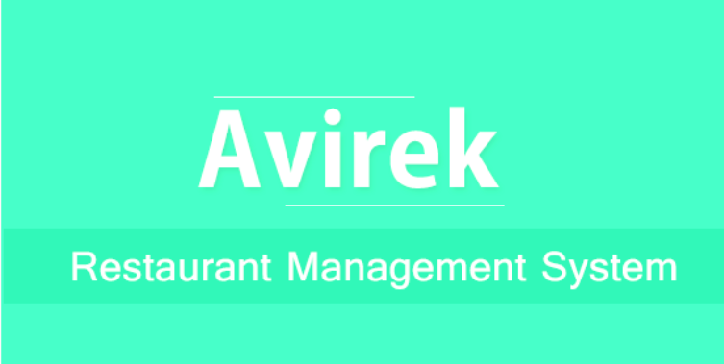
Observation
After we choose the idea, we observed the similar system in the different restaurants. We inspired by them and we noticed about the important features that are found in all the systems.

Slide 4

Sketches and Paper prototype
Then we translate our ideas about the system interface and functionalities into sketches. After we get a clear view, we started our paper prototype to know the sequence of functionalities before we starting the real prototype to decrease the effort.

Slide 5
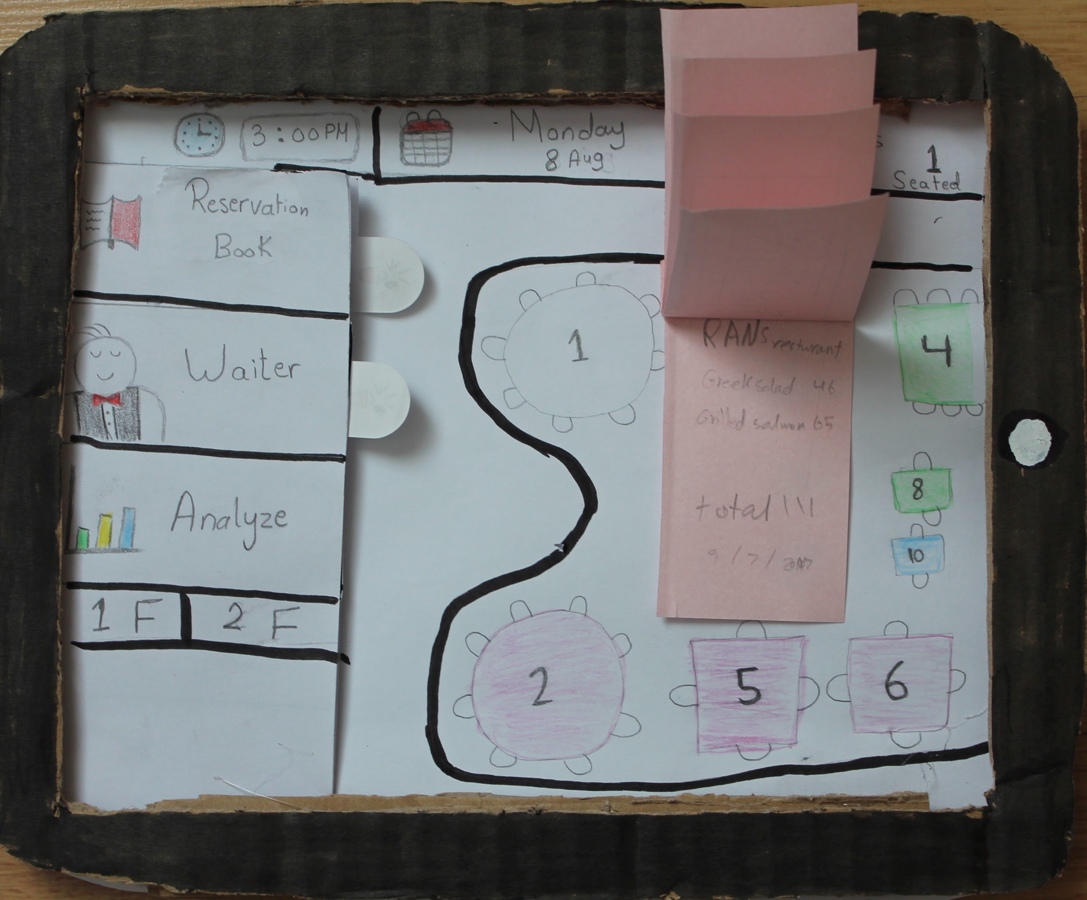
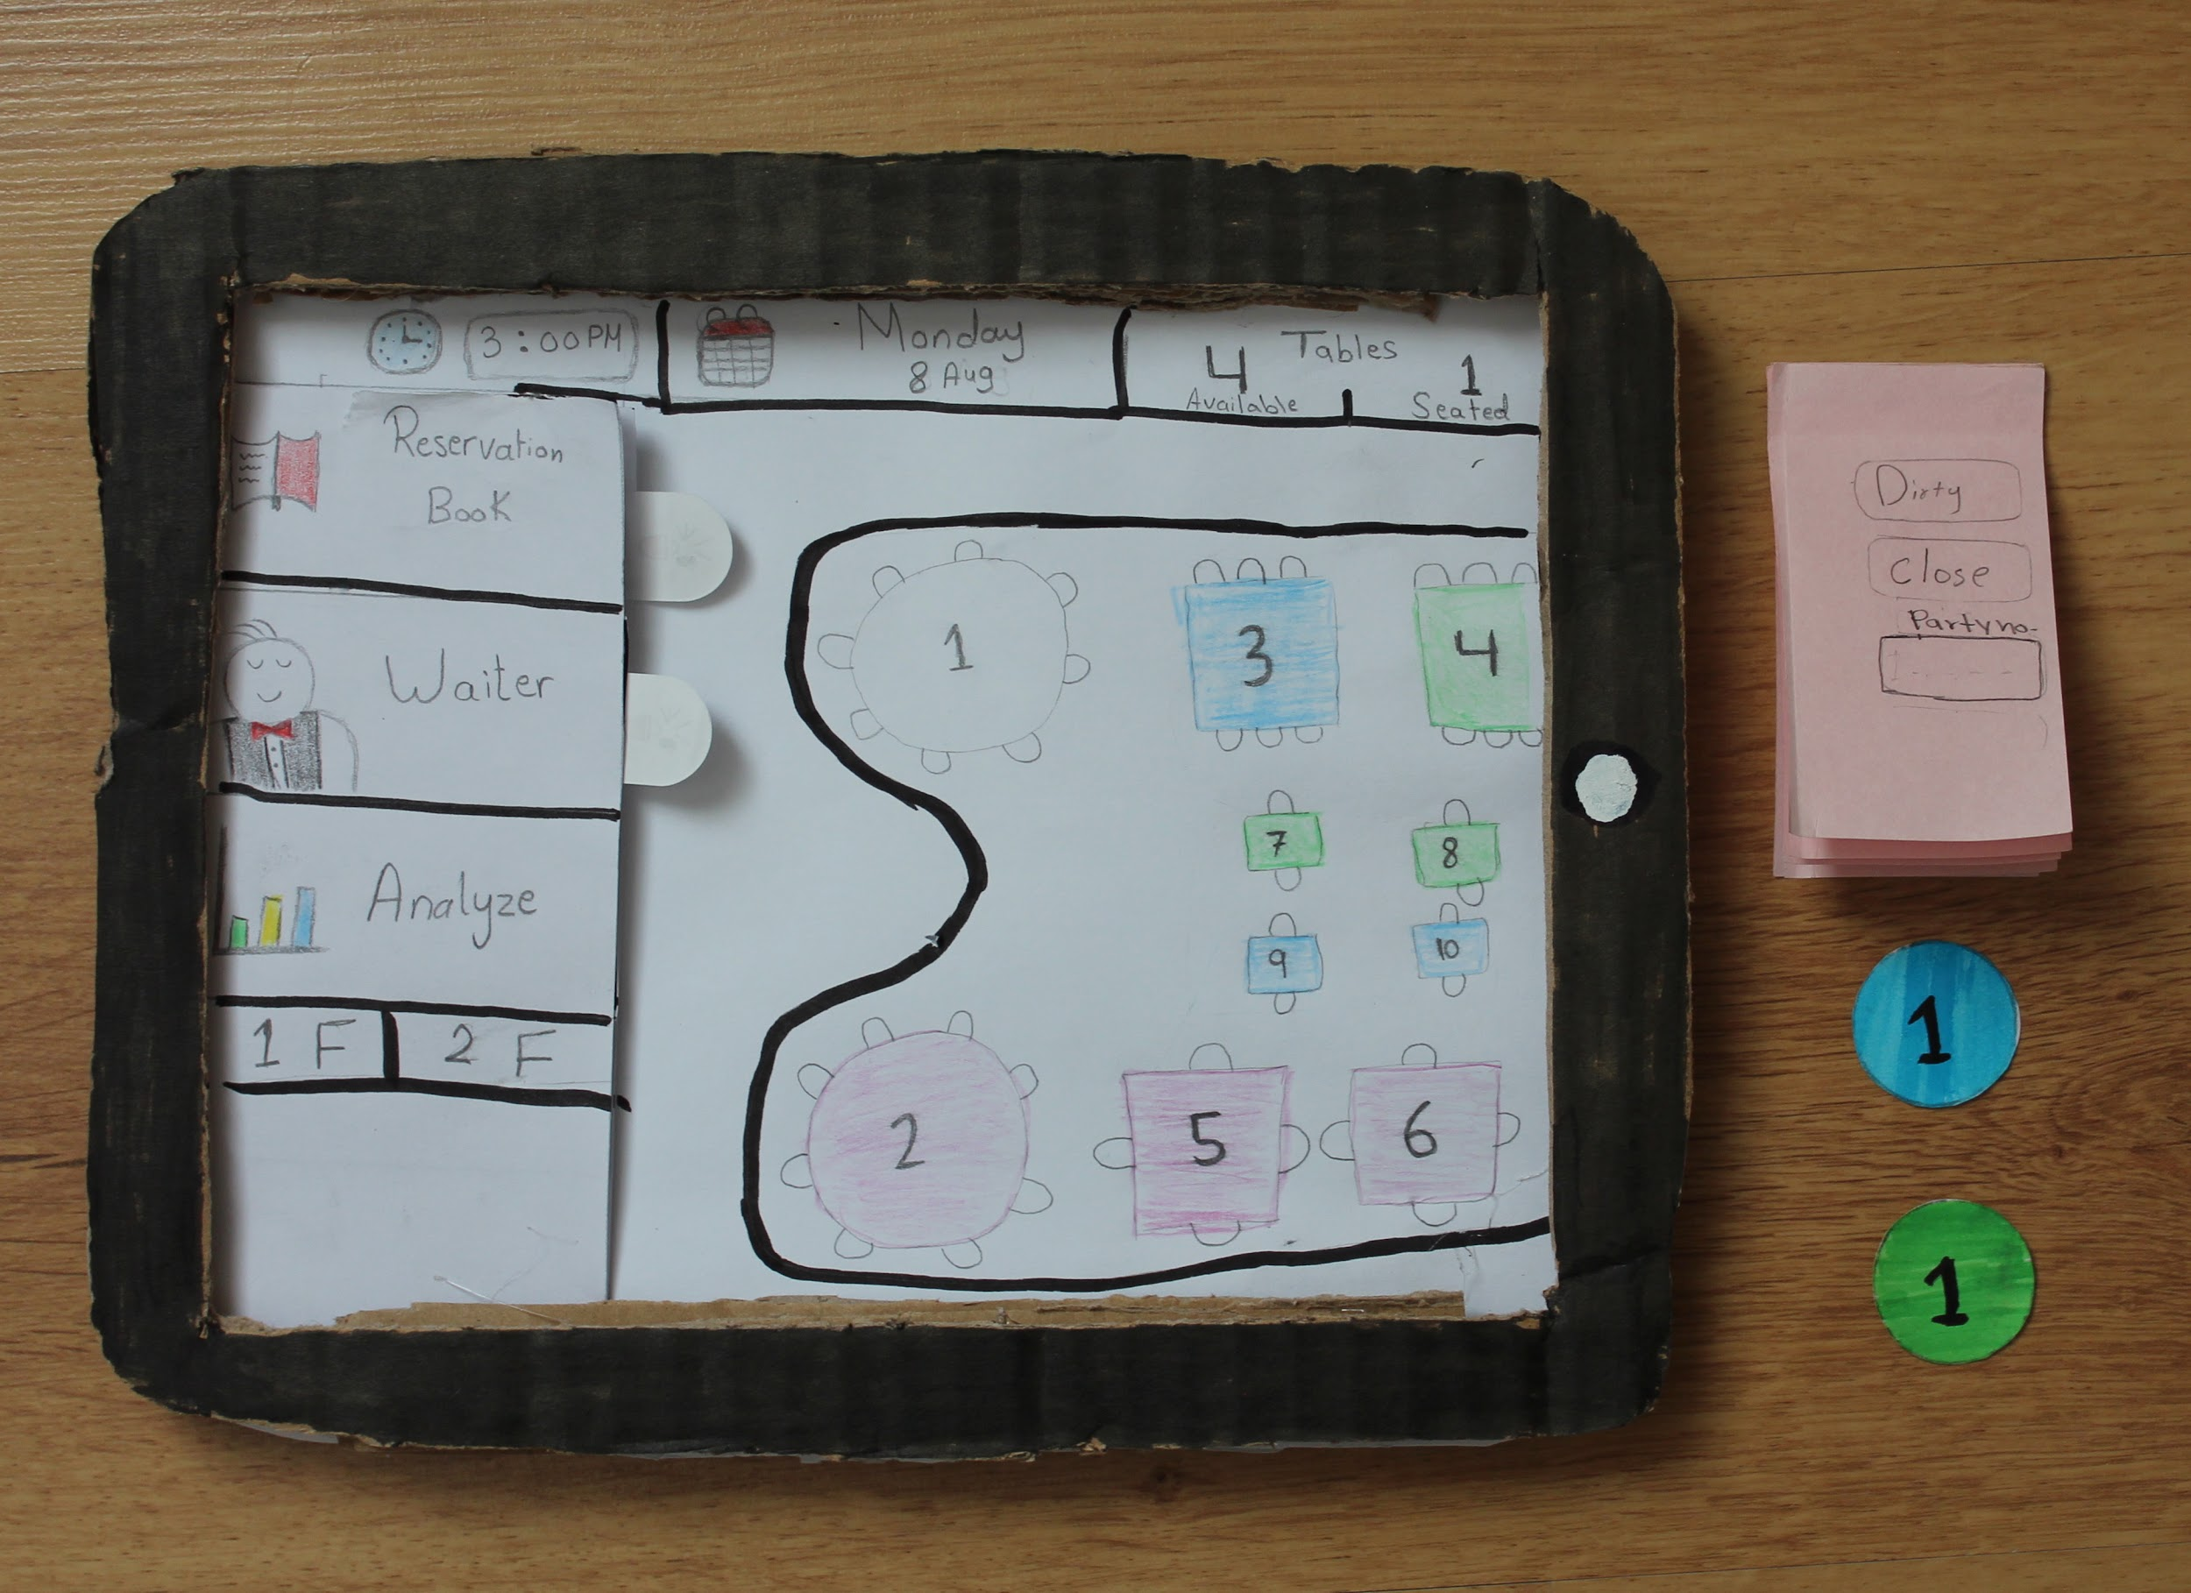

Slide 6

Dynamic prototype
Reverse the paper prototype the dynamic prototype concerned more on the interface colors and the design.
We used Proto.io to build it.

Slide 7
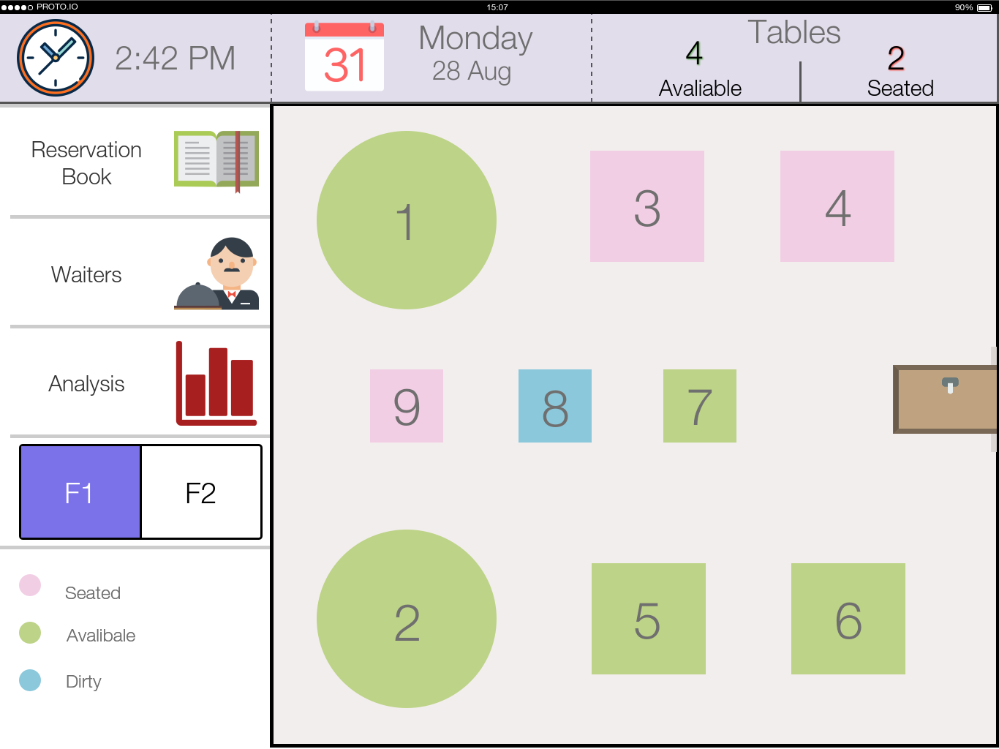

Slide 8
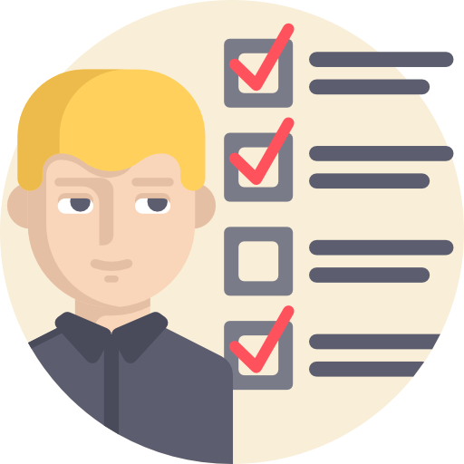
Usability testing
Finally, to measure the usability of the system we prepared for the usability testing which refers to evaluating a product or service by testing it with representative users. Typically, during a test, participants will try to complete typical tasks while observers watch, listen and takes notes. The goal is to identify any usability problems.
We perform it at the usability lab at the college of computer science.

Slide 9

Usability testing benefits
The usability testing helps us to know the unpredictable usability problems that we noticed from the participants. Also, it gives us a quantitative result about the usability which gives us the opportunity to improve our system UI.

Slide 10
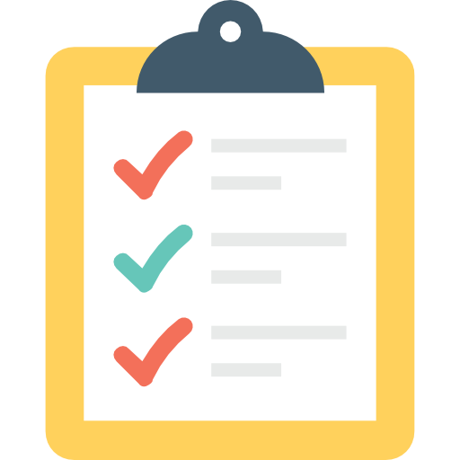
Tasks
Book new reservation for Hala.
Edit booked reservation time for Sara.
View tables assigned to waiter Jack.
Change table 2 state from available to seated.
Take table 2 order.
Show the bill for table 2.
Change table 2 state from seated to dirty.
Change table 2 state from dirty to available.

Slide 11
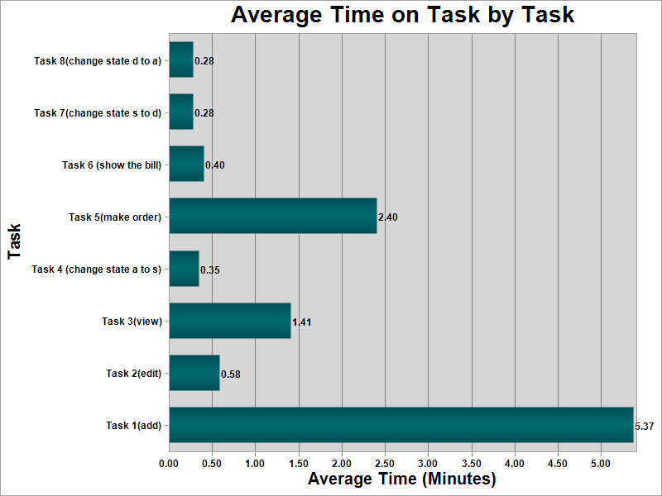
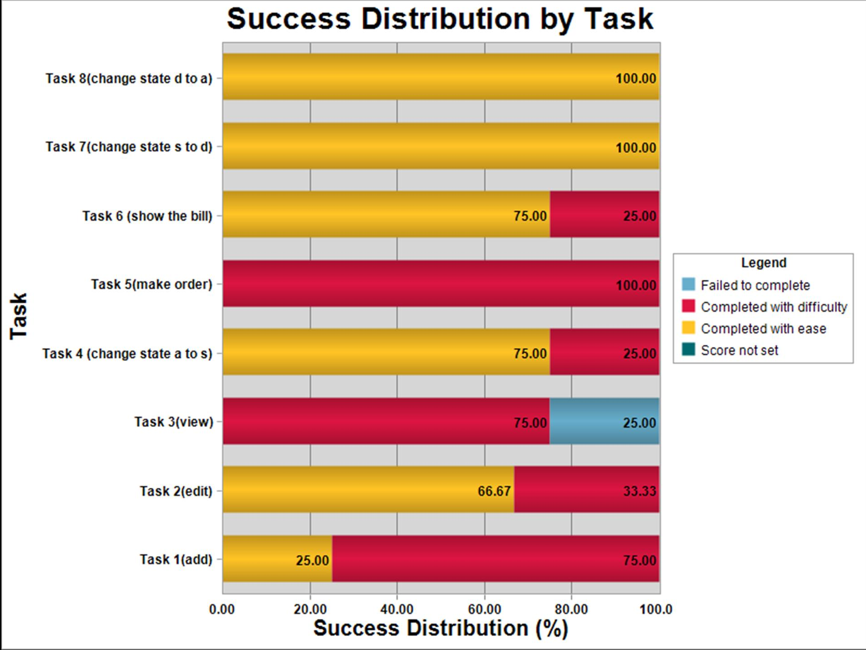
Usability Results

Slide 12
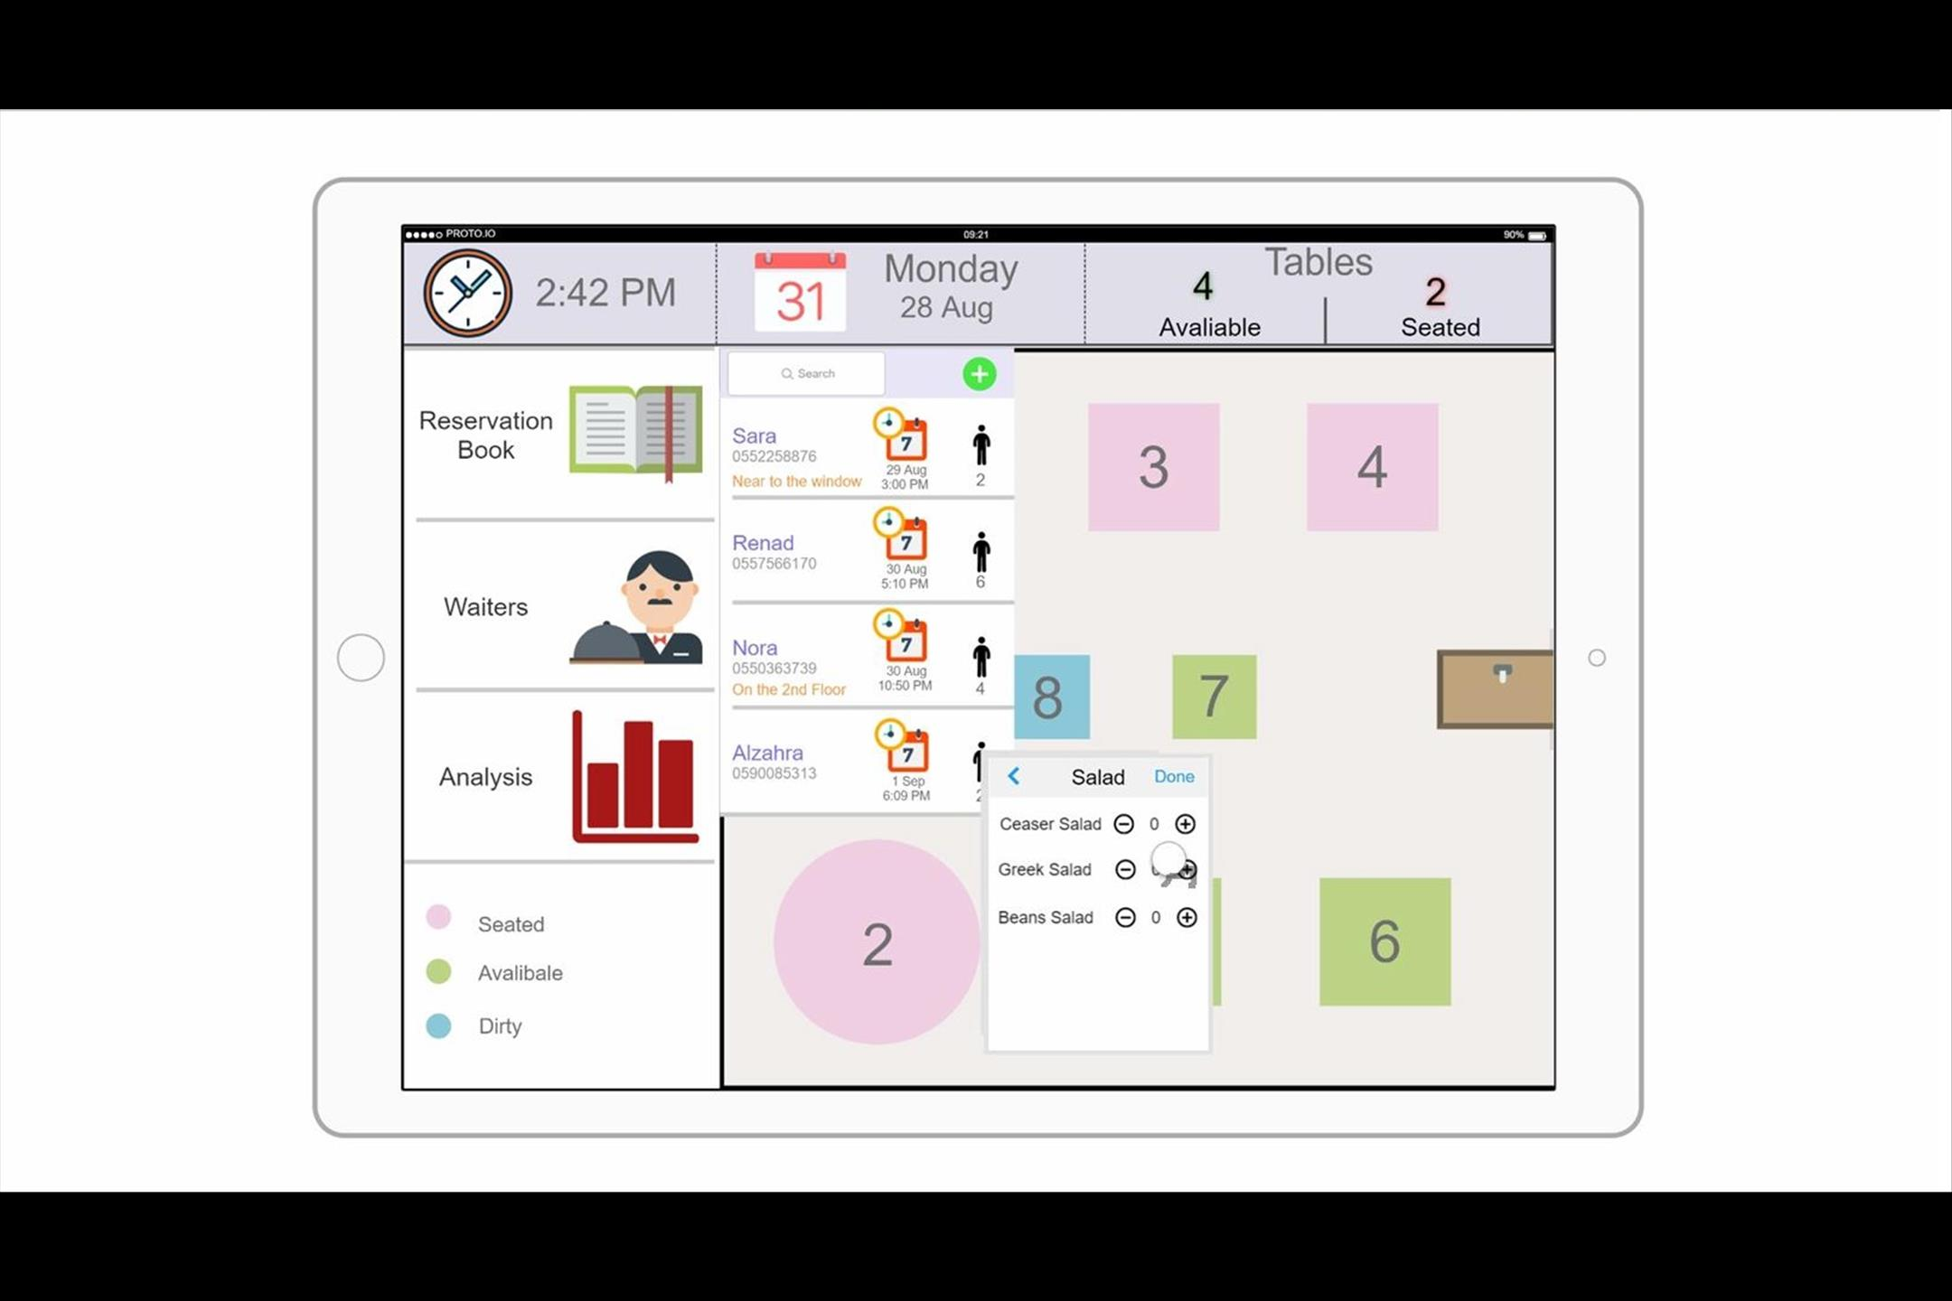
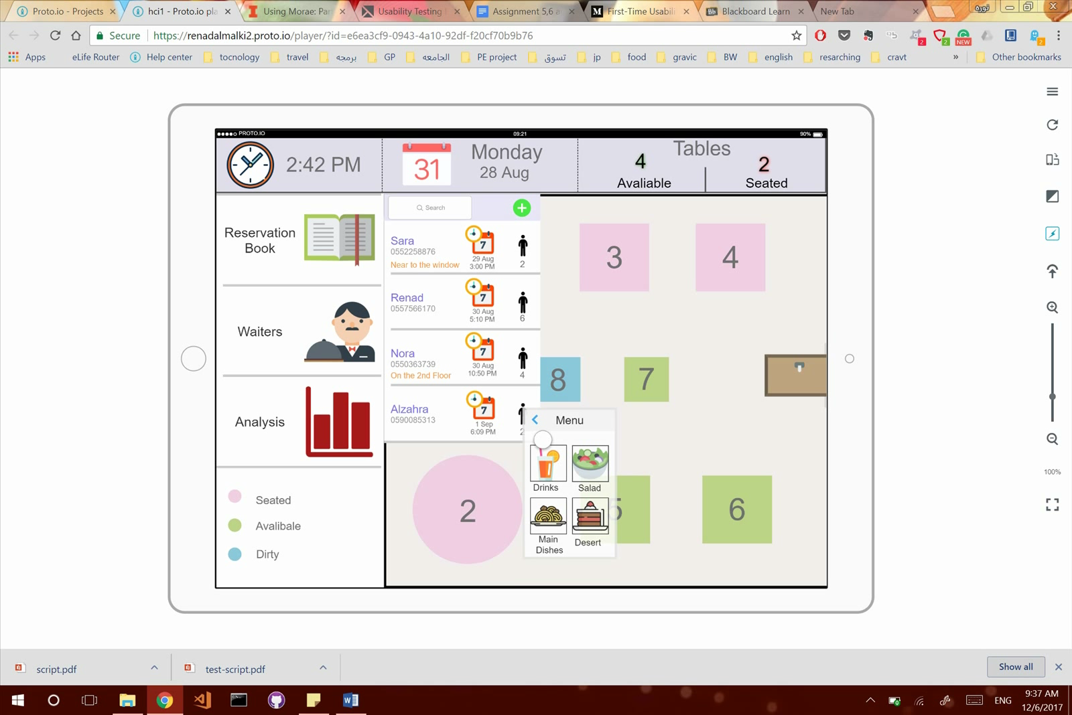
1.Make order task 1.1 Quantity problem
We can’t change it because that need real coding and data storing.
The + and – very clear to the user and easy to access.

Slide 13
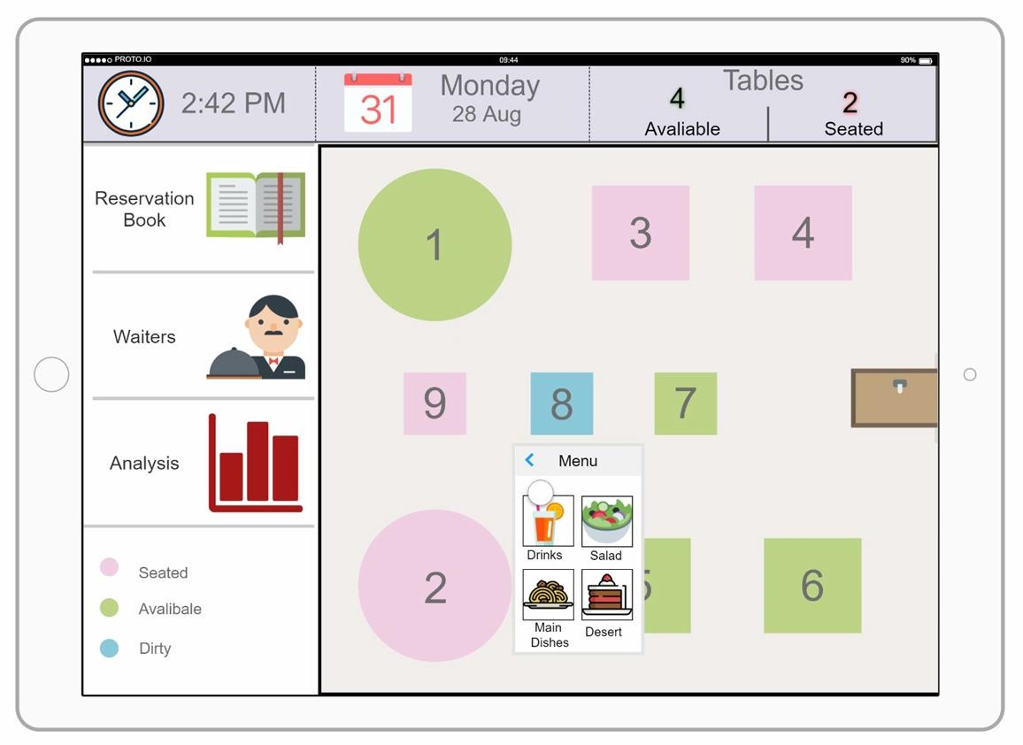
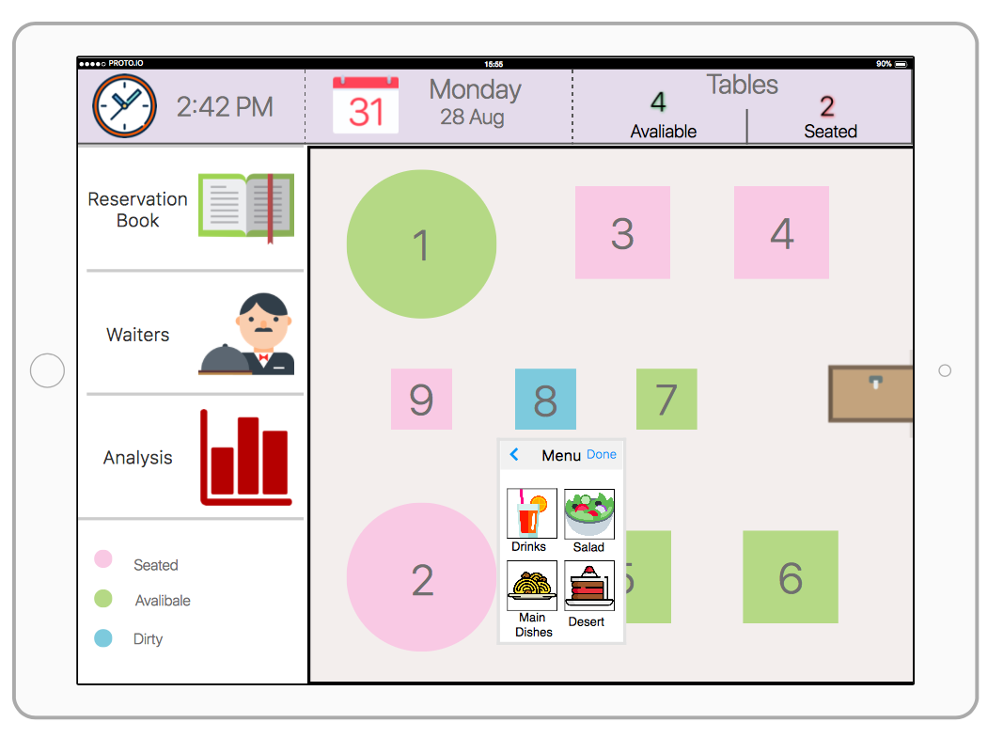
1.2 Done feedback

Slide 14
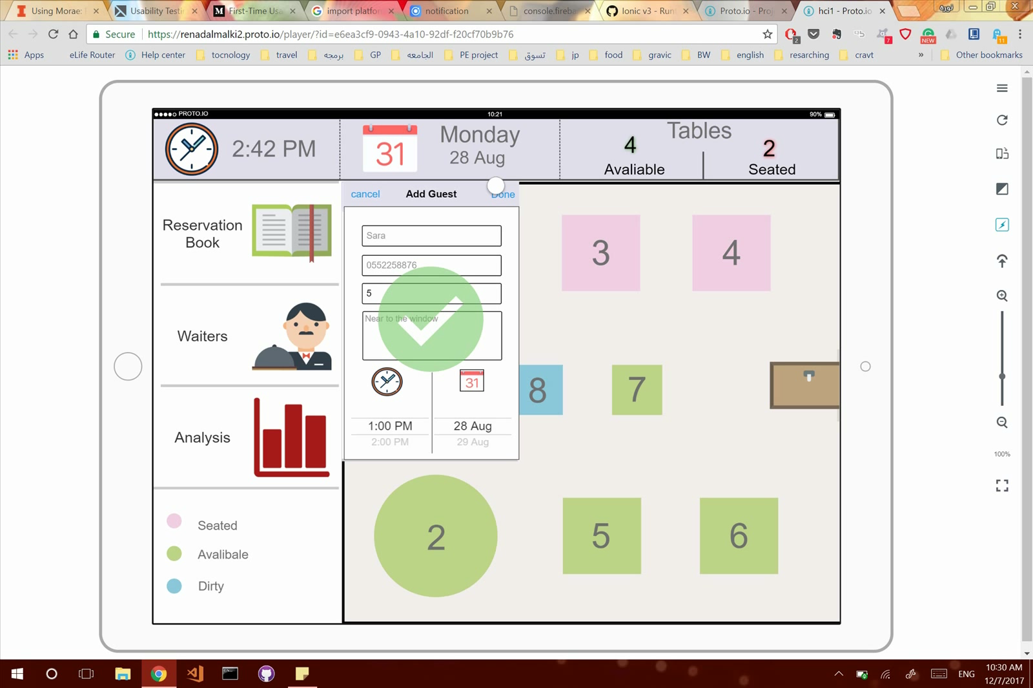
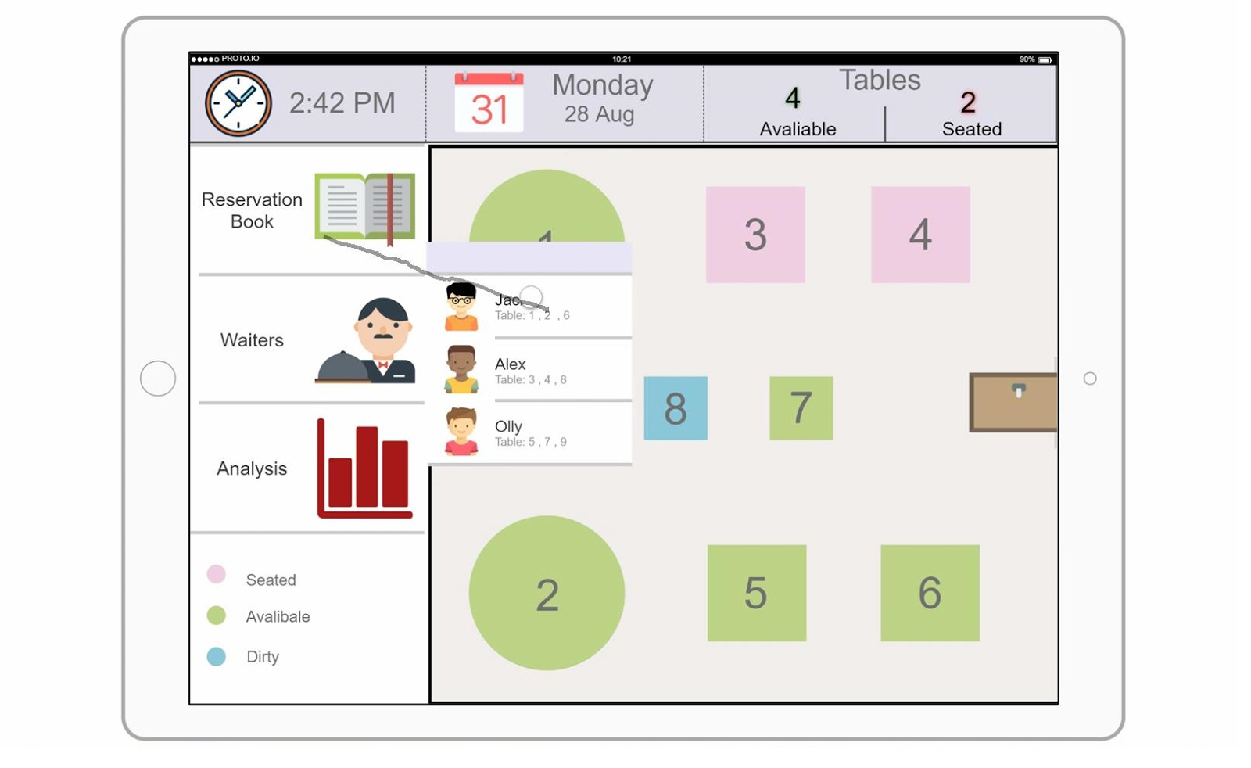
2.Close lists in View waiters task
To show waiters list you must close reservation list but how?

Slide 15
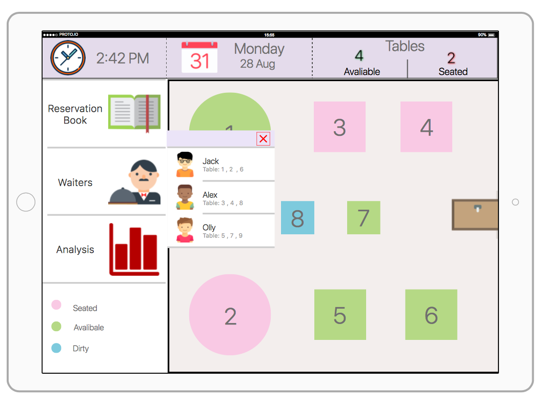
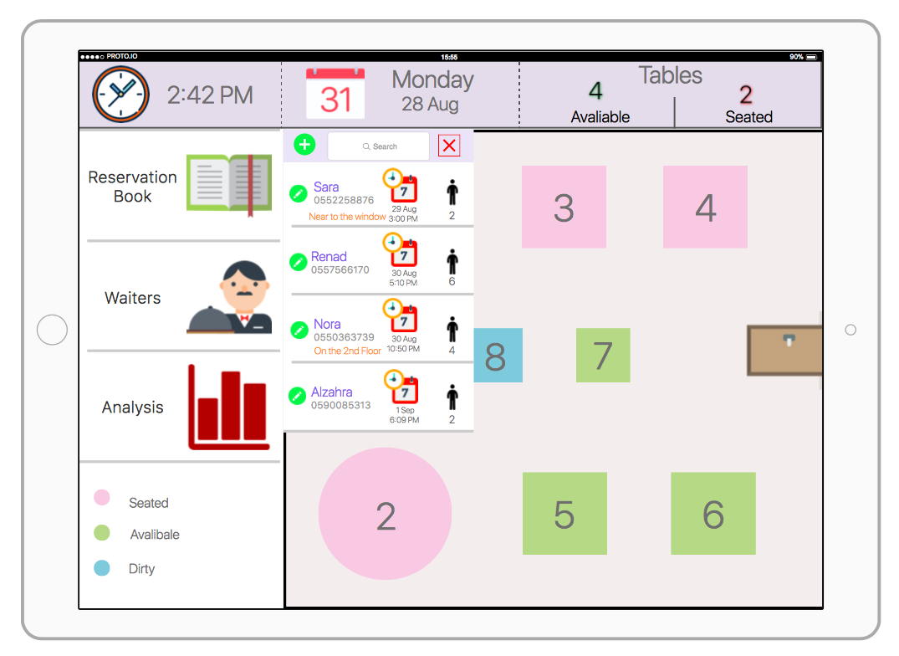
Solution → X button in top of lists

Slide 16
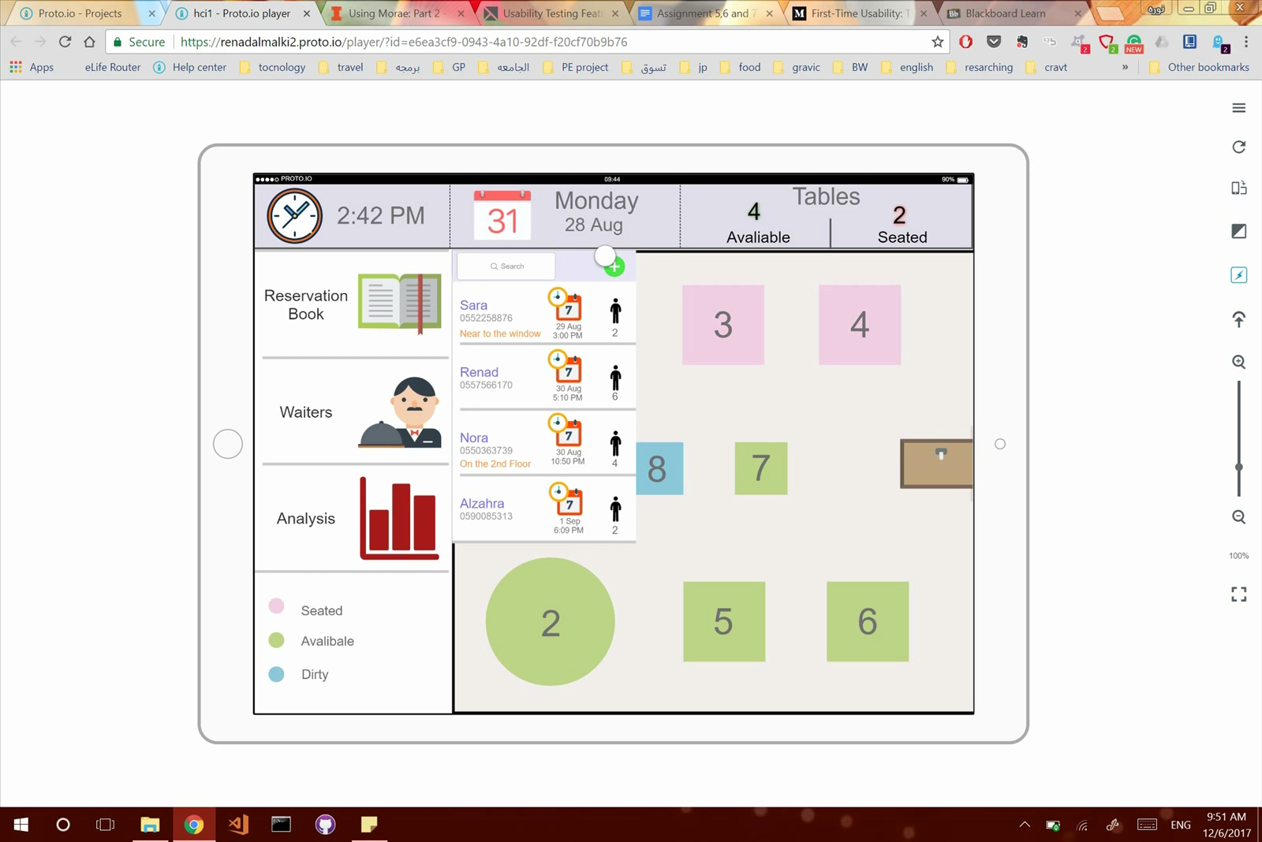
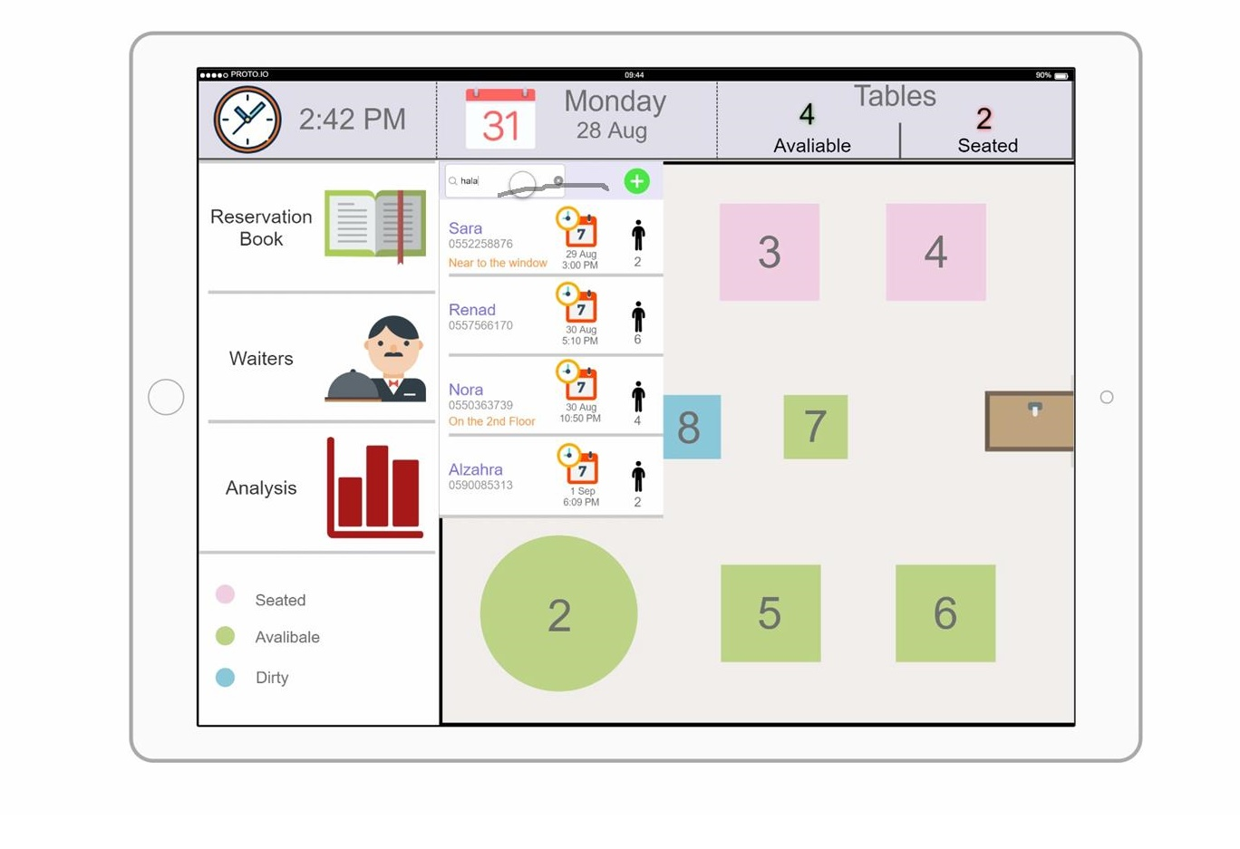
3. Book new reservation task 3.1 check added reservation
The booked reservation not appear with the list when you click done .

Slide 17
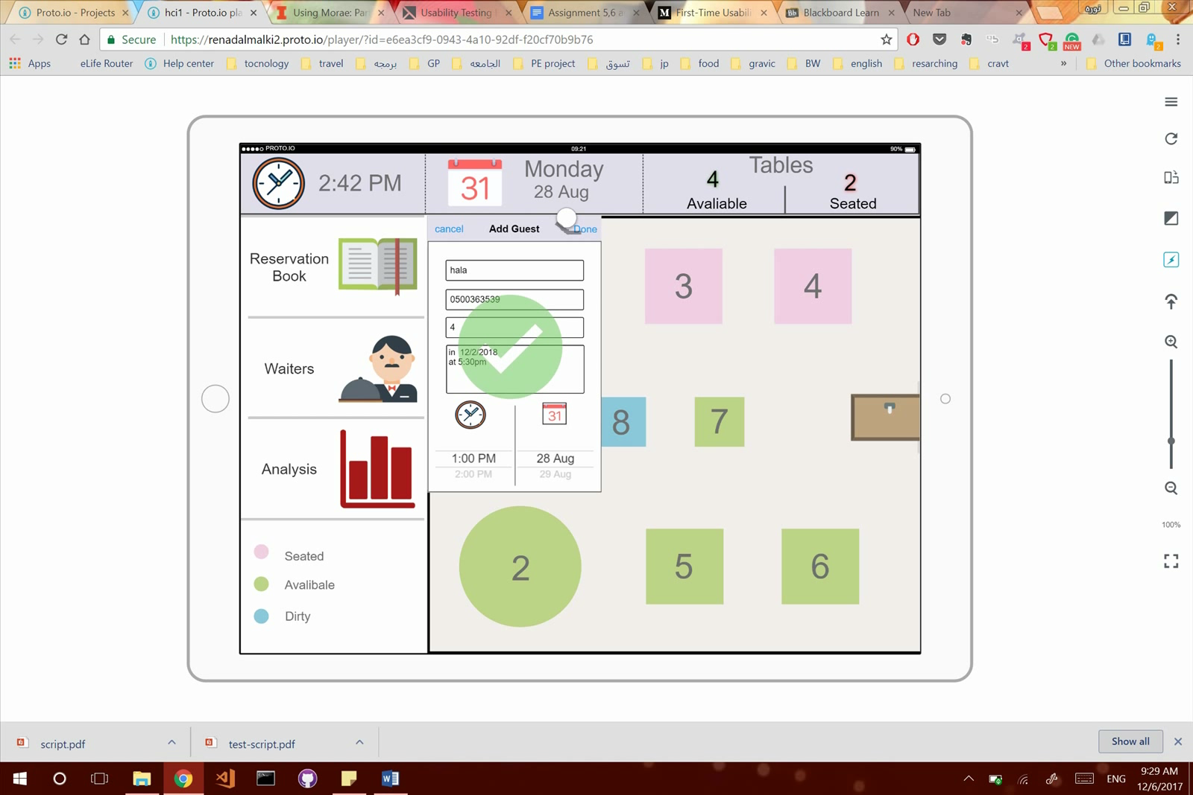
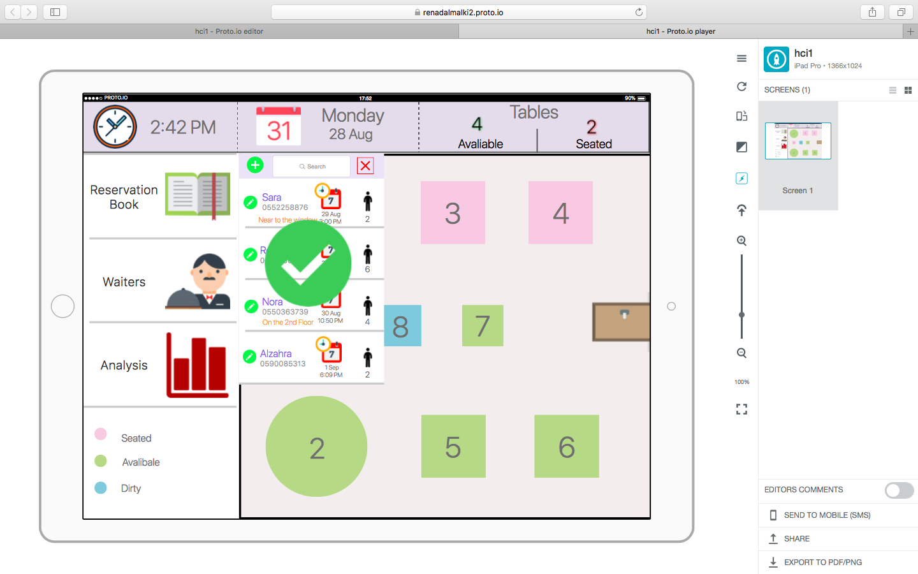
Temporary solution

Slide 18
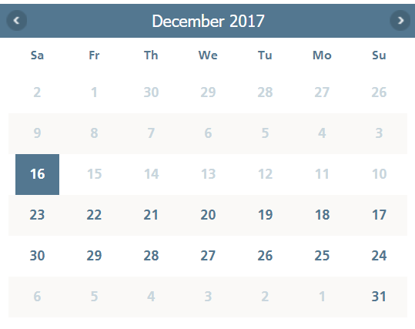
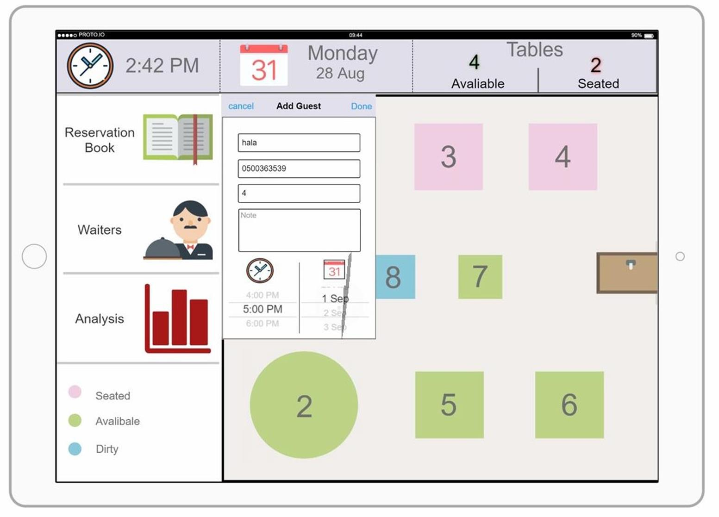
3.2 Date and time spinner

Slide 19
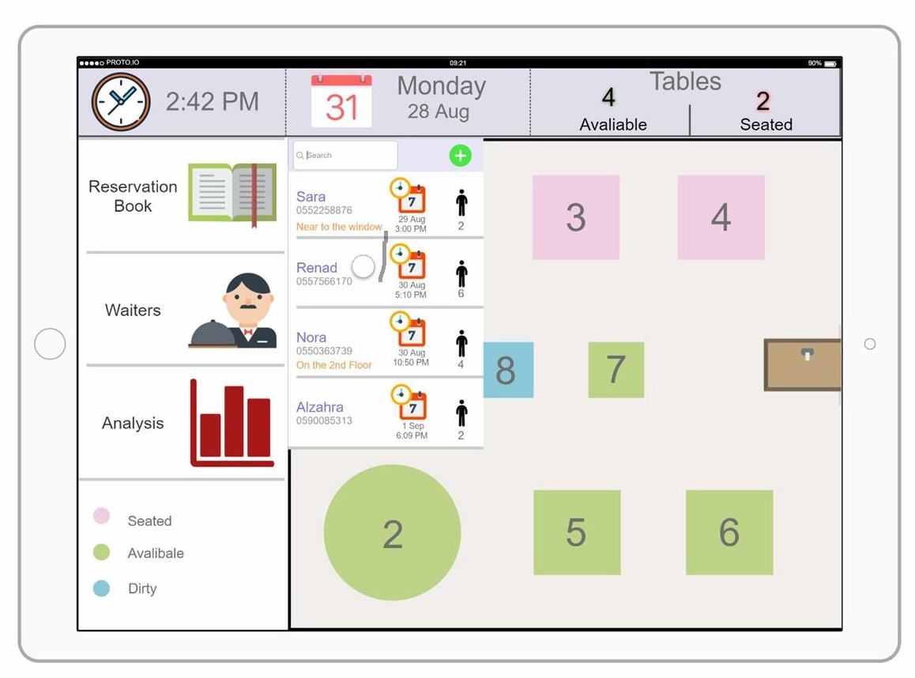
4. Access booked reservation to edit in edit booking task

Slide 20
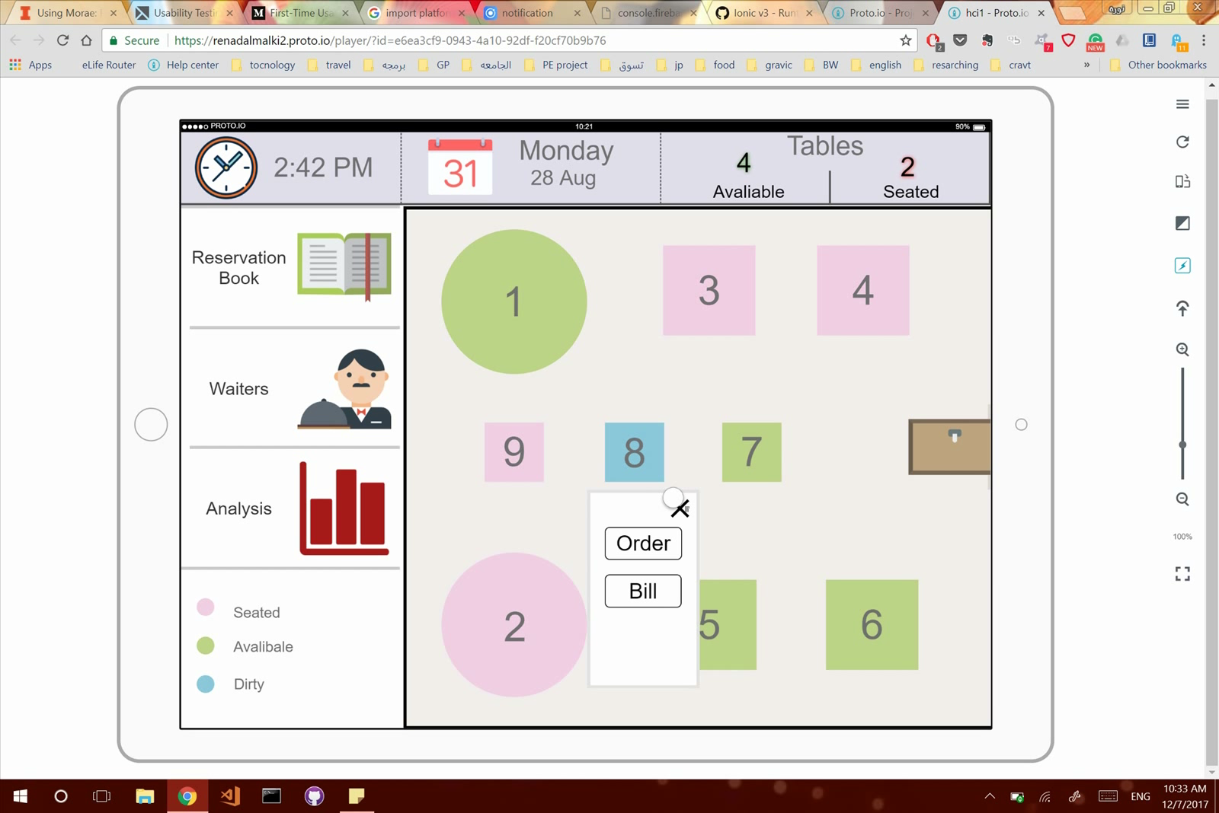
5.Show and close the bill in show bill task
Close button not clear for most users.

Slide 21
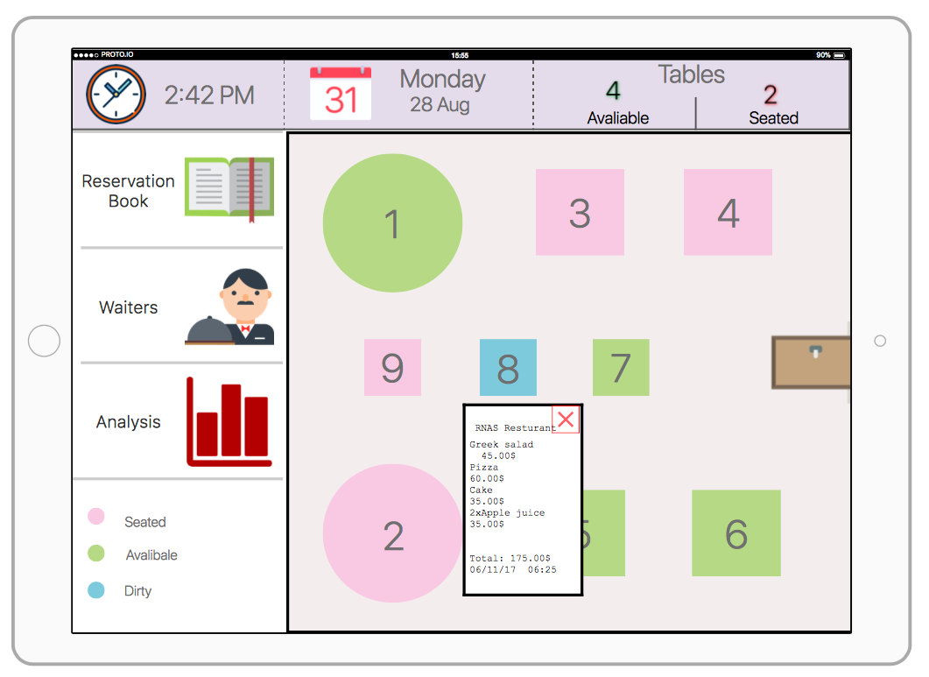
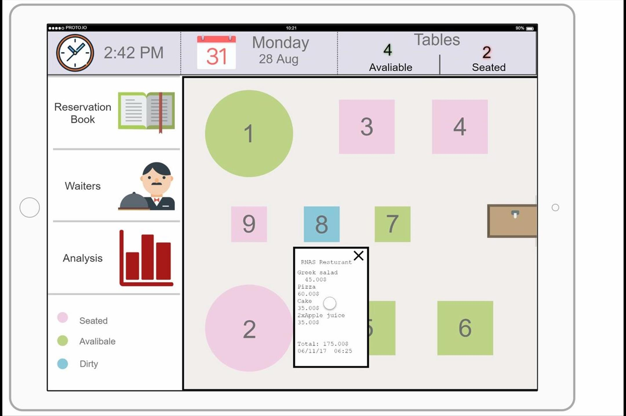
Solution → change X color and borders

Slide 22
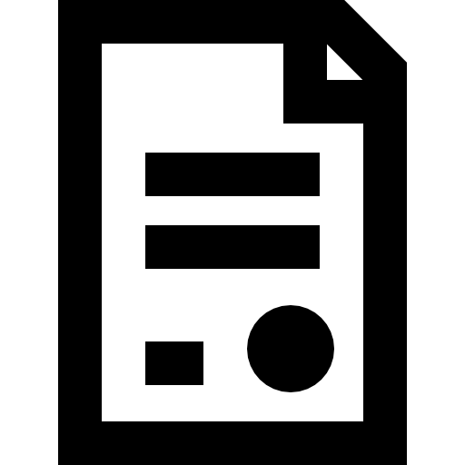
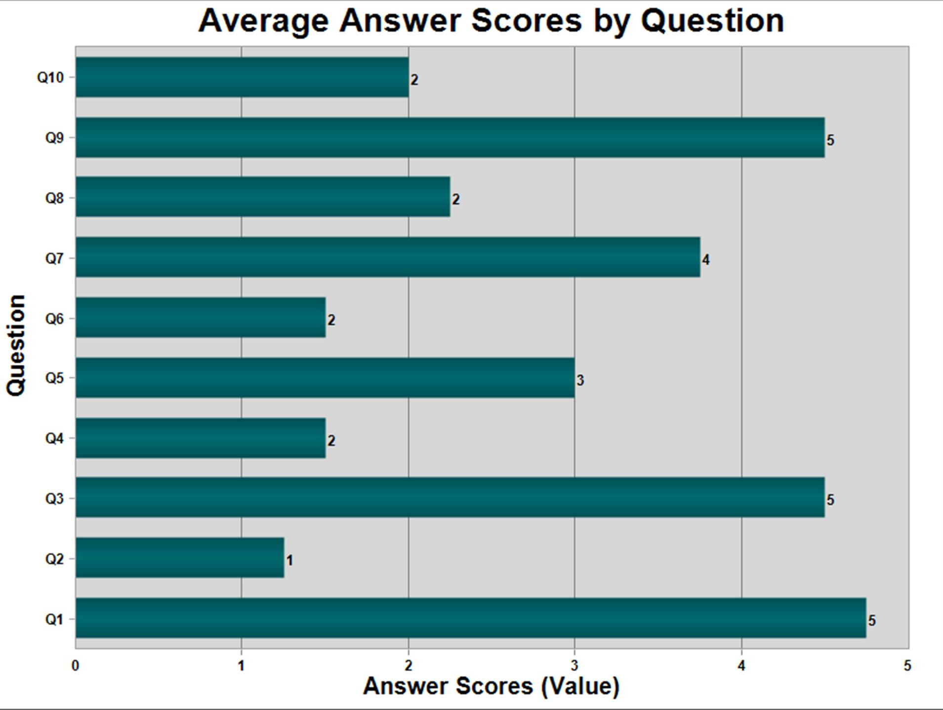
Survey Result
Most of the users want to use it again and again.
The system was not complex for most users.
The system was easy to use for most users.
Most of the users didn't need help to use the system.
Most of the users didn't agree that all functions are integrated well
Most of the users didn’t think that the system has too much inconsistency.
Most of the users imagine that most restaurants staff will learn to use the system very quickly.
Most of the users didn’t find the system cumbersome to use.
Most of the users were confident using the system.
Most of the users didn’t need any instruction to understand the system and work on it.

Slide 23




THANK YOU
Nora
Alkhunifer
Renad
Almalki
Sara
Almeshari
Alzahra
Alhowaish

